Slide 1
2nd Term Project
Analysis on Multi-Cycle Processor Design
and
Implementation of Pipelined Processor Design
TA: Gyudong Kim
Email: gyudong_kim@korea.ac.kr

Slide 2
Overview
Instruction Analysis
Multi-Cycle Processor Design
Analysis
Pipelined Processor Implementation
1st Term Project
2nd Term Project

Slide 3
Analysis on Multi-Cycle Processor Design
#1 Analyze given multi-cycle ARM processor source code
#2 Analyze Signal unit
#3 Draw block diagram of multi-cycle ARM processor
#4 Explain How the Test program works on the given processor

Slide 4
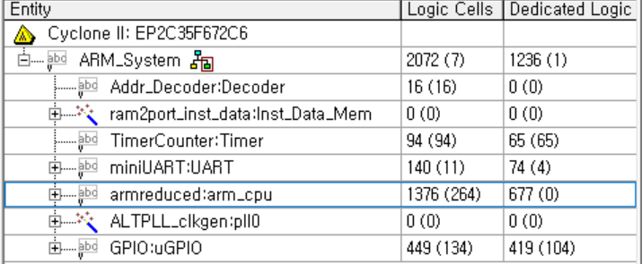
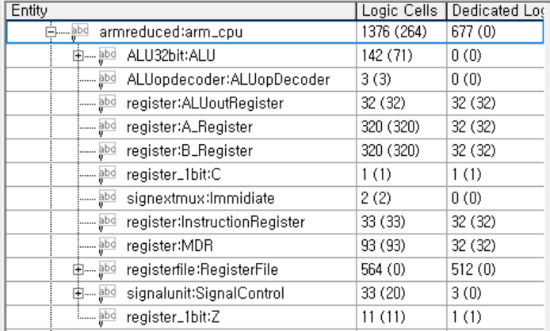
#1 Analyze given multi-cycle ARM processor source code
It has multiple modules that define different parts of an ARM processor.
interpret only the modules included here
“armreduced”: main module that ties all other modules to implement a simplified ARM processor, with registers, control logic, and a register file for executing different instructions.

Slide 5
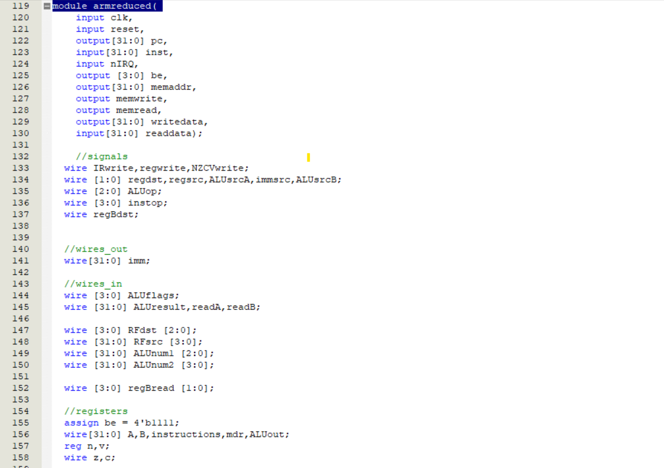
#1 Analyze given multi-cycle ARM processor source code
The inputs to the module are the clock signal (clk), reset signal (reset), interrupt signal (nIRQ), read data(readdata) and instruction (inst).
The outputs of the module are the program counter(pc), branch enable (be), memory address (memaddr), memory write enable (memwrite), memory read enable (memread), write data (writedata).
Q. Where the output ports of ‘armreduced’ go?
the outputs of ‘armreduced’ could be connected to other modules within a larger system or to external devices, such as memory or input/output peripherals.

Slide 6
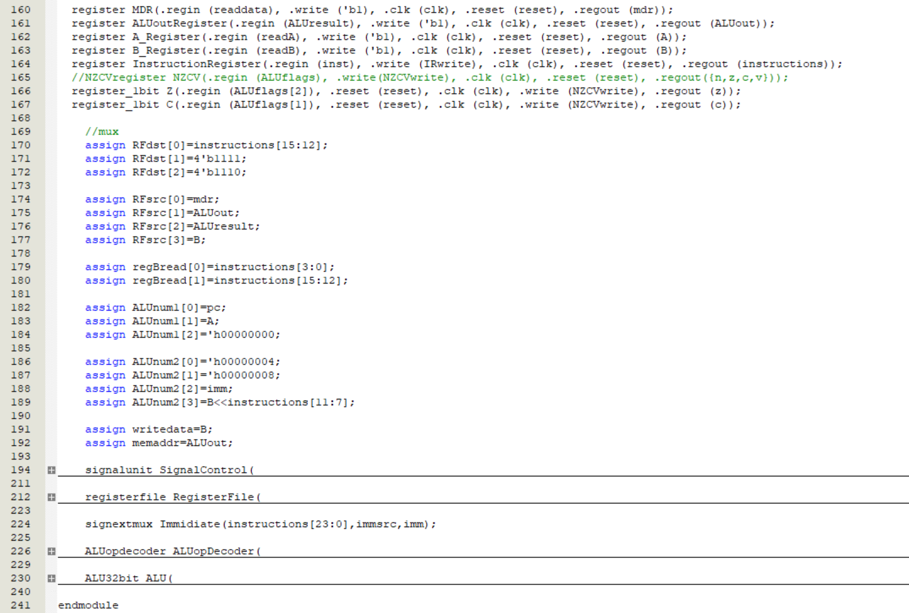
#1 Analyze given multi-cycle ARM processor source code
Inside the ‘armreduced’ module, there are several sub-modules that perform specific functions of the processor.
‘register’
‘register_1bit’
‘registerfile’
‘signextmux’
‘ALUopdecoder’
‘ALU32bit’
‘signalunit’

Slide 7
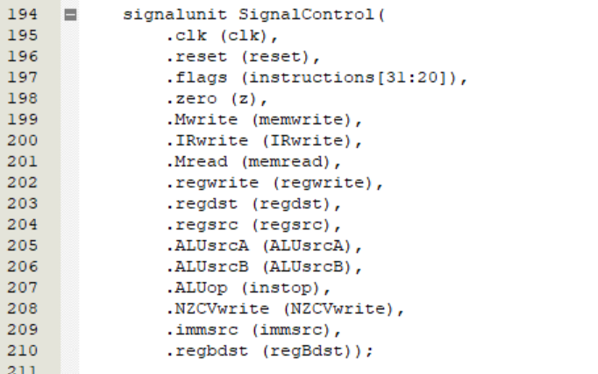
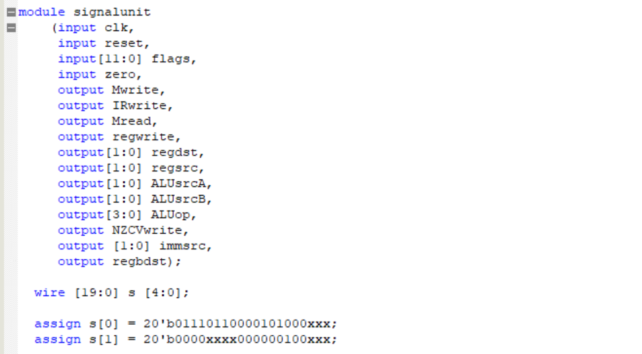
#2 Analyze Signal unit
ARMCPU.v
ctrlSig.v
‘signalunit’ module generates control signals for the simplified ARM processor. It takes various inputs, including flags, zero, clock, and reset, and generates 12 output signals that are used to control the operation of the processor.
This is the top-level module that combines the functionality of the ‘signalcontrol’ and ‘oneAdder’ modules.

Slide 8
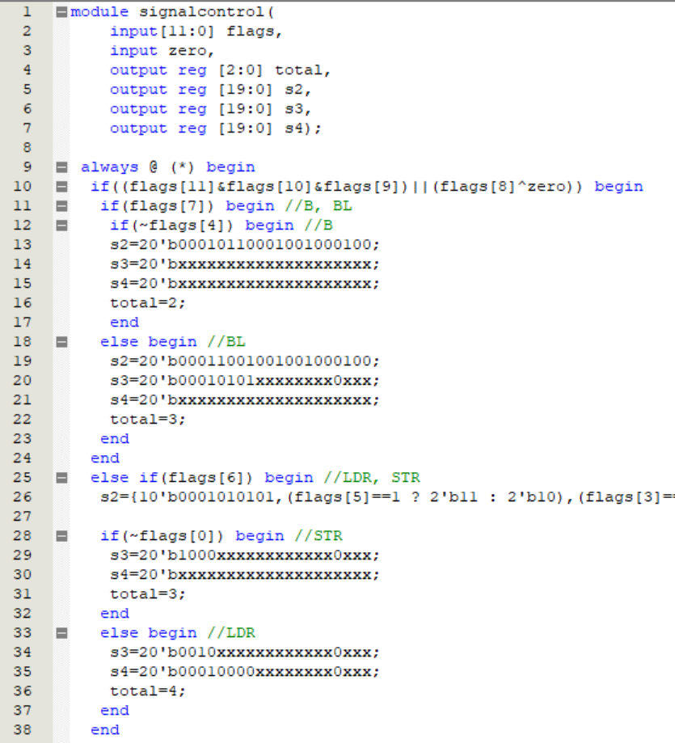
#2 Analyze Signal unit
ctrlSig.v
The always block in the ‘signalcontrol’ module checks the flags and conditions to decide the appropriate control signals and the number of steps required for each operation.

Slide 9
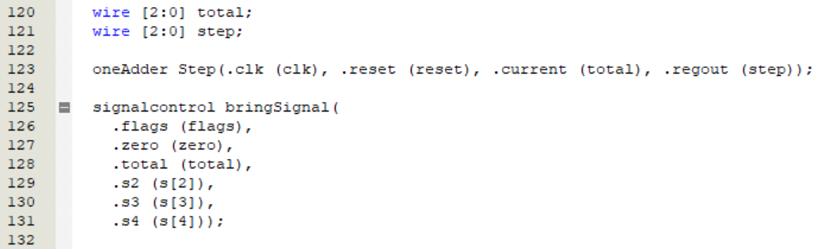
#3 Draw block diagram of multi-cycle ARM processor
ctrlSig.v
input
output
※ Follow the input and output of each module carefully.
The ‘total’ wire originates in the ‘signalcontrol’ module, indicating the number of steps needed to complete a specific instruction. It connects to the current input of the ‘oneAdder’ module in the ‘signalunit’

Slide 10
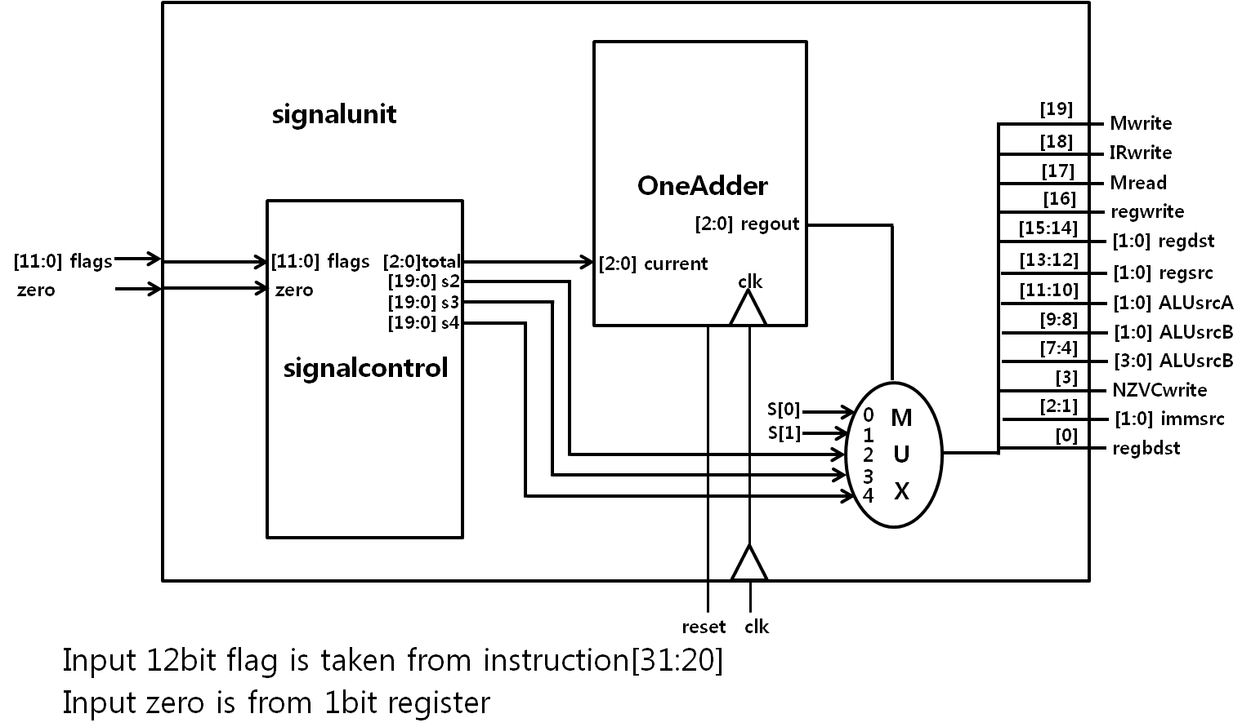
#3 Draw block diagram of multi-cycle ARM processor
Example of Block diagram
‘signalunit’ module
You also need to create a block diagram of the entire 'armreduced' module.

Slide 11
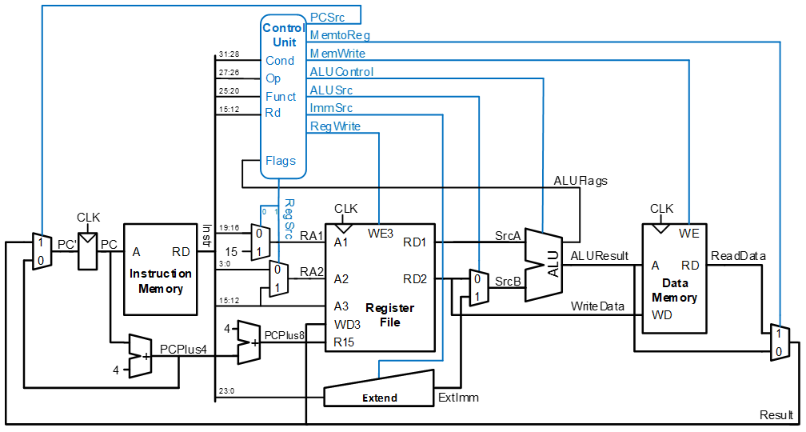
#3 Draw block diagram of multi-cycle ARM processor
Example. Single-Cycle Processor

Slide 12
#4 Explain How the Test program works on the given processor
<Test Program>
MOV r1, #0
ADD r1, r1, #1
LDR r1, [ r0, #0xC ]
BEQ reset
Mwrite ~ regbdst
Instructions should be analyzed with the control signals according to the clock cycle

Slide 13
Analysis on Multi-Cycle Processor Design(15pt)
#1 Analyze given multi-cycle ARM processor source code(4)
#2 Analyze Signal unit(3)
#3 Draw block diagram of multi-cycle ARM processor(4)
#4 Explain How the Test program works on the given processor(4)

Slide 14
Implementation of Pipelined Processor Design
#1 Implement Pipelined Processor
#2 Explain your Implementation

Slide 15
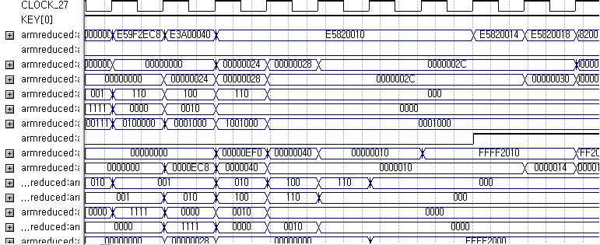
#1 Implement Pipelined Processor
Example of successful timing simulation result
You need to handle ‘data hazard’ and ‘control hazard’

Slide 16
#1 Implement Pipelined Processor… + α
If you want to test your implementation on FPGA board, please contact TA
Things that you should consider, if you want to test your code on Real FPGA board.
Timing Issues: The FPGA board may have different timing characteristics than your simulation. Make sure you have correctly set up and analyzed the timing constraints for your target FPGA
I/O Pin Assignment: Make sure that your I/O pin assignments are correct and match the FPGA board's pin layout. Incorrect pin assignments can lead to unexpected behavior.
Check if your design is using more resources (logic elements, memory blocks, DSP blocks, etc.) than available on the target FPGA.
Ensure that all registers and memory elements are properly initialized in your design
Clock generation and distribution can be different between simulation and the FPGA board, leading to unexpected behavior.

Slide 17
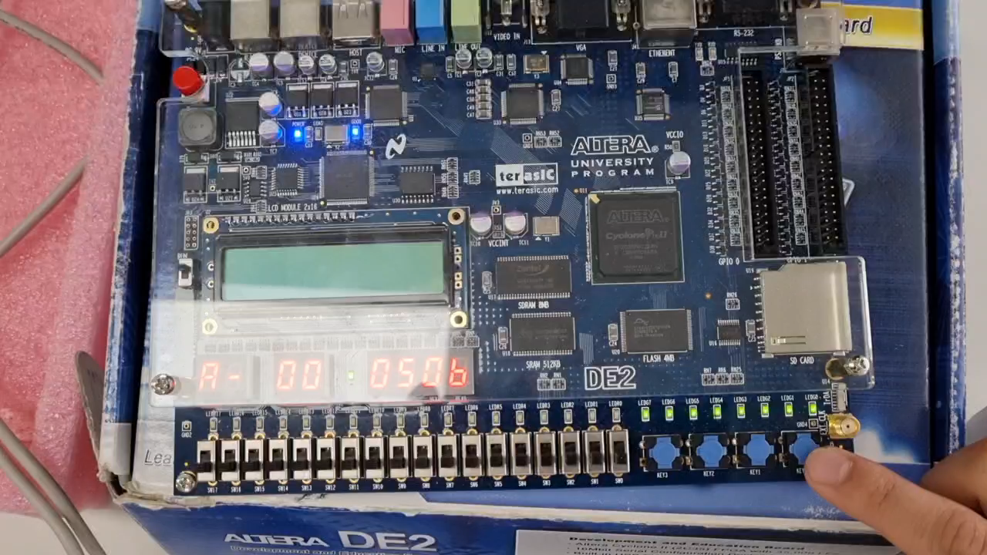
#1 Implement Pipelined Processor… + α
Target board: Altera DE2 Board

Slide 18
#2 Explain your Implementation
Include
Overview of the pipelined ARM processor
Explanation about control signals
How you handle Data hazard
How you handle Control hazard
Limitation and more idea

Slide 19
Implementation of Pipelined Processor Design(10pt)
#1 Implement Pipelined Processor(6)
#2 Explain your Implementation(4)

Slide 20
Review
Analysis on Multi-Cycle Processor Design(15pt)
#1 Analyze given multi-cycle ARM processor source code(4)
#2 Analyze Signal unit(3)
#3 Draw block diagram of multi-cycle ARM processor(4)
#4 Explain How the Test program works on the given processor(4)
Implementation of Pipelined Processor Design(10pt)
#1 Implement Pipelined Processor(6)
#2 Explain your Implementation(4)
You can write report both in Korean and English

Slide 21
Submission
Due date
06/16 (Fri) 11:59 P.M.
How to submit (Only one person for one team)
Through KULMS
Report
Submission format: PDF
‘CA2_ANALYSIS_STUDENTNUMBER_NAME.pdf’
‘CA2_IMPL_STUDENTNUMBER_NAME.pdf’
Implementation
Submission format: ZIP
Compress ‘ARM_System’ and ‘ARM_System_Syn’ folders to submit.
‘CA2_IMPL_STUDENTNUMBER_NAME.ZIP’

Slide 22
Reference
Verilog https://www.chipverify.com/verilog/verilog-tutorial
Altera DE2 Board
http://www.terasic.com.tw/cgi-bin/page/archive.pl?Language=English&CategoryNo=183&No=30&PartNo=2#heading

